Slide 1


Data-Driven Storytelling Presentation:
Store Sales Analysis

Slide 2
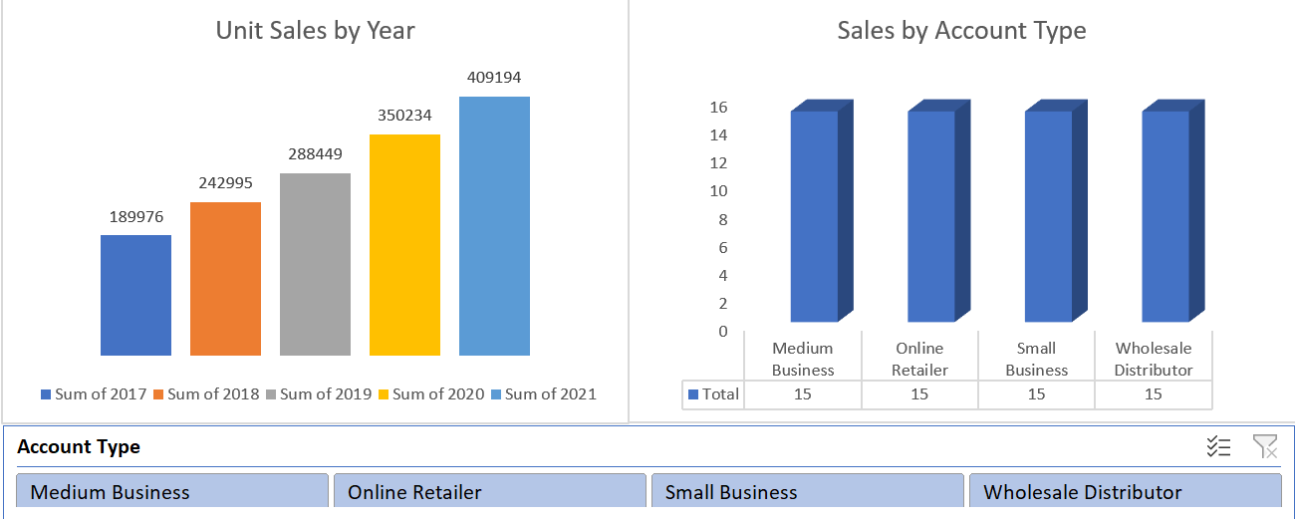
Sales sorted out with year and Account type.

Slide 3
Key point, observation or data here…
Sales are the key factor in business that generates revenue.
It kept gradually increasing on a yearly basis.
Category Constant Performance over the whole time.

Slide 4
Summary
Sales are increasing on a yearly basis and the category of products or services is performing consistently. This is a good sign for the business, and it is likely to continue to be successful in the future.

